Slide 1

CS 584 Machine Learning
Week 4
September 11, 2019

Slide 2

Week 4 Agenda: Clustering
K-Means Clustering
Describe algorithm, step-by-step
Determine the number of clusters
Bi-Clustering
Cluster both observations and variables
Spectral Clustering
Handle data which the K-Means cannot
Preprocess data before applying the K-Means
Chapter 7 of the Machine Learning book

Slide 3
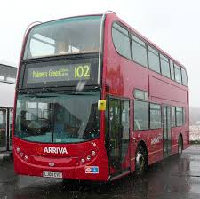
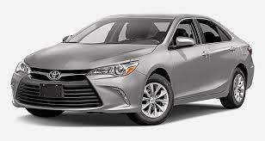

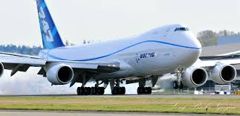
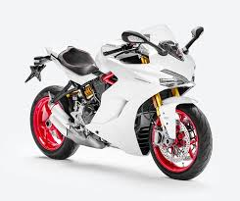
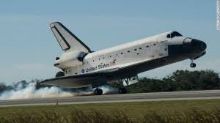
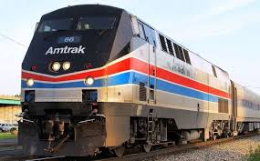




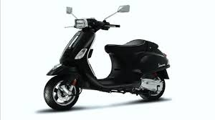
Group These Motorized Vehicles

Slide 4
Group By Our Six Sense …

Slide 5
Quantitatively, Group By What Criteria?
Physical Attributes
Number of Passengers? 1, 2, 3, 4, …
Number of Wheels? 0, 2, 4, …
Presence of Wings? 0 or 1
Weight? 300 lb. (motorcycle) to Infinity
Top Speed? 23 mph (cruise ship) to 17,500 mph (space shuttle)
Maximum Payload? 200 lb. (motorcycle), 50 tons (space shuttle), 248 tons (747), 50,000 tons (cruise ship) to Infinity (freight train)

Slide 6
Quantitatively, Group By What Criteria?
Socio-Economic Attributes
Sticker Price? $20,000 (car) to Infinity
Personal Ownership? 0 or 1
Travel Environment? Sea, Land, Air, or Space
Satisfaction of Owning The Vehicle? High, Medium, and Low

Slide 7
How Many Groups?
Obvious choices of the number of groups:
Minimum one group
Maximum twelve groups (as there are twelve vehicles)
Can we do better?
The number of groups is an integer between 1 and 12
The vehicles within each group are as less heterogeneous (a.k.a. less dissimilar) as possible
How do we measure the degree of dissimilarity?

Slide 8
Cluster Analysis: Overview
Motivation: Consider the observations come from multiple populations
Objective: Discover and identify clusters among observations
Objects within the same cluster are as similar as possible
Objects from different clusters are as dissimilar as possible
These clusters represent their respective populations
Process: Partition the observations into disjoint clusters
Similar observations are put into the same cluster
Observations in different clusters are dissimilar

Slide 9
Cluster Analysis: What is a Cluster?
The short answer is: a cluster is a collection of observations.
From a statistician point of view, a cluster is a collection of observations that have similar characteristics of attributes.
From a domain expert point of view, a cluster is a gathering of observations that share some common business values that are reflected by their similar characteristics of attributes.
A statistician’s job is to discover the clusters, a domain expert’s job is to give the clusters identities – what the clusters tell us about the observations.
As a data scientist, you are expected to do both jobs.

Slide 10
Cluster Analysis
Specifications for Clustering:
What is the definition of “similar” or “dissimilar”?
How to assign observations into clusters?
How many clusters are there (or do we need)?
Post-Clustering:
How do we describe the clusters?
What are the dominant characteristics of clusters?

Slide 11
Cluster Analysis: What is Similar or Dissimilar?
We use a distance metric to measure similarity or dissimilarity.
Suppose there are three observations: x₁, x₂, and x₃. We will say that x₁ is similar to x₂, but dissimilar to x₃ if d(x₁,x₂) < d(x₁,x₃) where d(.,.) is a distance metric.
A function is a distance metric if it has the following four properties:
Non-negativity: d(x₁,x₂) ≥ 0
Coincidence: d(x₁,x₂) = 0 if and only if x₁ = x₂
Symmetry: d(x₁,x₂) = d(x₂,x₁)
Triangle Inequality: d(x₁,x₂) + d(x₂,x₃) ≥ d(x₁,x₃)

Slide 12
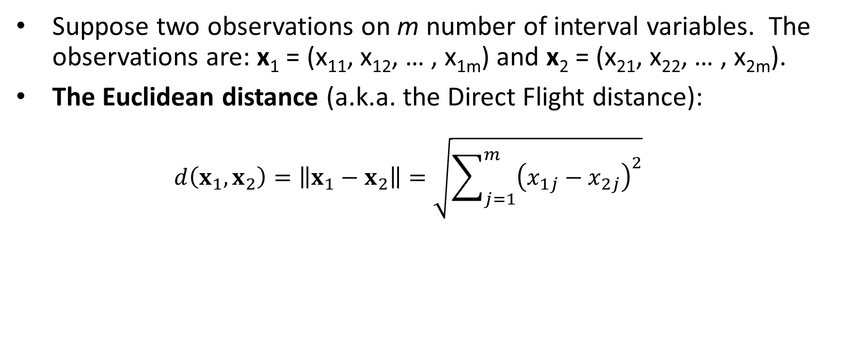
Distance Metric for Interval Variables
Suppose two observations on m number of interval variables. The observations are: x₁ = (x₁₁, x₁₂, … , x_{1m}) and x₂ = (x₂₁, x₂₂, … , x_{2m}).
The Euclidean distance (a.k.a. the Direct Flight distance): $d\left(x_{1},x_{2}\right)=\left\|x_{1}−x_{2}\right\|=\sqrt{\sum_{j=1}^{m}{{\left(x_{1j}−x_{2j}\right)}^{2}}}$

Slide 13
Normalization of Interval Variables
If all variables are measured in the same units (for example, feet) or of similar variances, then normalization might not be necessary.
Otherwise, some form of normalization is recommended because variables that have substantially larger variances tend to affect the distance measure more than variables that have smaller variances.

Slide 14
Normalization for Interval Variables
Standardization
The transformation is (value – mean) / (standard deviation).
The resulting variable has a mean of 0 and a variance of 1.
Range
The transformation is (value – minimum) / (maximum – minimum).
The resulting variable has a minimum of 0 and a maximum of 1.

Slide 15
Cluster Analysis: Centroids
Centroids represent the center of a cluster
Centroids give identity to a cluster
Centroids are usually the arithmetic means of the interval variables
If we can visualize a cluster as a two-dimensional ellipse, then the centroid of the cluster is the center of the ellipse.
X

Slide 16
Cluster Analysis: Cluster Identifier
Clusters are sequentially labeled from 1 to the number of clusters (or from 0 to one less than the number of clusters)
The Cluster Identifiers are integers
The Cluster Identifiers do not indicate the discovery order of the clusters, the relative magnitudes of the centroids, or any relationships among the clusters

Slide 17
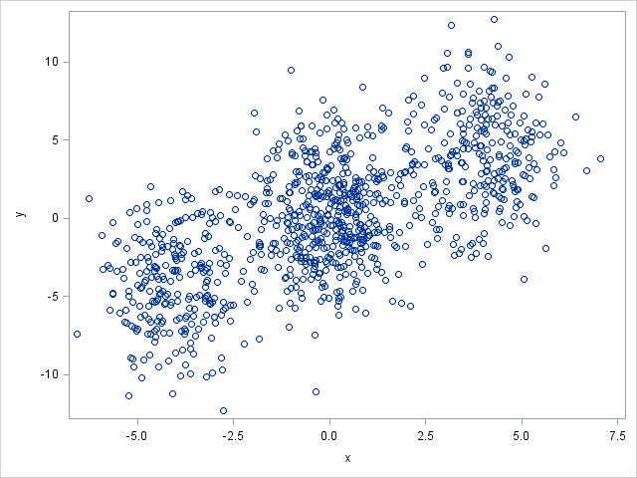
The Basic Idea of the K-Means Algorithm
Assign observations into non-overlapping hyperspheres
The radii of hyper-spheres are as small as possible
Each observation must belong to one and only one hyper-sphere

Slide 18
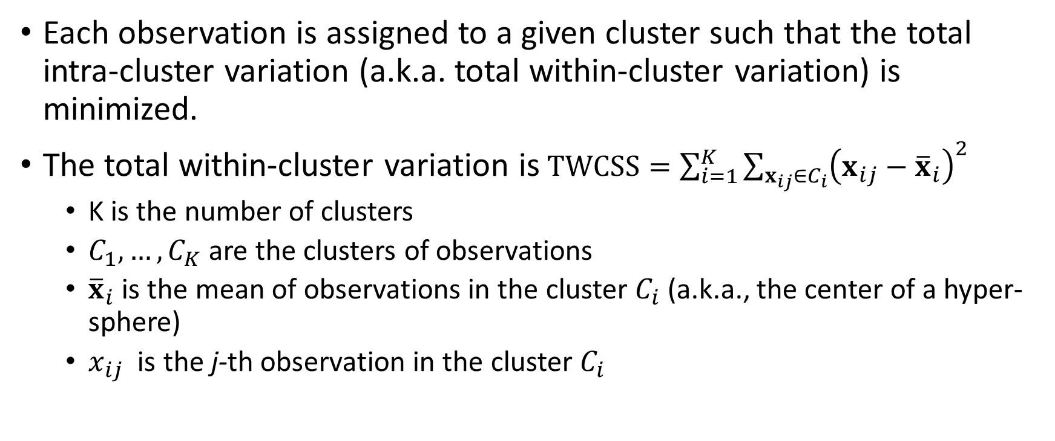
The Basic Idea of the K-Means Algorithm
Each observation is assigned to a given cluster such that the total intra-cluster variation (a.k.a. total within-cluster variation) is minimized.
The total within-cluster variation is$TWCSS=\sum_{i=1}^{K}{\sum_{x_{ij}∈C_{i}}{{\left(x_{ij}−{\overline{x}}_{i}\right)}^{2}}}$
K is the number of clusters
$C_{1},…,C_{K}$ are the clusters of observations
${\overline{x}}_{i}$ is the mean of observations in the cluster $C_{i}$ (a.k.a., the center of a hyper-sphere)
$x_{ij}$ is the j-th observation in the cluster $C_{i}$

Slide 19
Cluster Analysis: K-Means Algorithm
Summary of the K-Means Algorithm:
Specify the number of clusters (K > 1)
Select K observations as initial centroids
Repeat
Form K clusters by assigning all observations to the closest centroids
Re-compute centroids of all K clusters
Until the Total Within-Cluster variation converges (in practice, check that the centroids converge within a tolerance limit)

Slide 20
Cluster Analysis: Initial Centroids
Common strategies for choosing the initial centroids
Scan the first K complete records and use their values as initial centroids (i.e., first complete record’s values are the first cluster’s initial centroid, and so on)
Randomly choose K complete records and use their values as initial centroids (used by the sklearn.cluster.Kmeans)
Usually, the choice of the initial centroids will not affect the final results. It may impact the number of iterations.

Slide 21
History of the K-Means Algorithm
K-means is often referred to as Lloyd’s algorithm.
Lloyd, S. P. (1957). "Least square quantization in PCM". Bell Telephone Laboratories Paper.
Pulse-code modulation (PCM) is a method used to digitally represent sampled analog signals.
Republished later as Lloyd., S. P. (1982). "Least squares quantization in PCM”. IEEE Transactions on Information Theory. 28 (2): 129–137.
Forgy, E. W. (1965). "Cluster analysis of multivariate data: efficiency versus interpretability of classifications". Biometrics. 21: 768–769.
Hartigan, J. A., and Wong, M. A. (1979). “Algorithm AS 136: A K-Means Clustering Algorithm”. Applied Statistics. 28(1): 100-108.

Slide 22
Simple Example
Five observations in ascending order: 0.1, 0.3, 0.4, 0.8, and 0.9
Find the two clusters solution using the Euclidean distance
For one dimension, this distance is simply the absolute difference
Iteration 1:
Initial centroids: C1 = 0.1, C2 = 0.3
Distance from C1: 0, 0.2, 0.3, 0.7, and 0.8 (WCSS = 0)
Distance from C2: 0.2, 0, 0.1, 0.5, and 0.6 (WCSS = 0.62)
Total WCSS = 0.62
Cluster membership: 1, 2, 2, 2, 2
New centroid: C1 = 0.1, C2 = (0.3+0.4+0.8+0.9)/4 = 0.6
Week 4 Kmeans.py

Slide 23
Simple Example
Five observations: 0.1, 0.3, 0.4, 0.8, and 0.9
Find the two clusters solution using the Euclidean distance
Iteration 2:
Initial centroids: C1 = 0.1, C2 = 0.6
Distance from C1: 0, 0.2, 0.3, 0.7, and 0.8 (WCSS = 0.04)
Distance from C2: 0.5, 0.3, 0.2, 0.2, and 0.3 (WCSS = 0.17)
Total WCSS = 0.21
Cluster membership: 1, 1, 2, 2, 2
New centroid: C1 = (0.1+0.3)/2 = 0.2, C2 = (0.4+0.8+0.9)/3 = 0.7

Slide 24
Simple Example
Five observations: 0.1, 0.3, 0.4, 0.8, and 0.9
Find the two clusters solution using the Euclidean distance
Iteration 3:
Initial centroids: C1 = 0.2, C2 = 0.7
Distance from C1: 0.1, 0.1, 0.2, 0.6, and 0.7 (WCSS = 0.06)
Distance from C2: 0.6, 0.4, 0.3, 0.1, and 0.2 (WCSS = 0.05)
Total WCSS = 0.11
Cluster membership: 1, 1, 1, 2, 2
New centroid: C1 = (0.1+0.3+0.4)/3 = 0.267, C2 = (0.8+0.9)/2 = 0.85

Slide 25
Simple Example
Five observations: 0.1, 0.3, 0.4, 0.8, and 0.9
Find the two clusters solution using the Euclidean distance
Iteration 4:
Initial centroids: C1 = 0.267, C2 = 0.85
Distance from C1: 0.167, 0.003, 0.133, 0.533, and 0.633 (WCSS = 0.0467)
Distance from C2: 0.75, 0.55, 0.45, 0.05, and 0.05 (WCSS = 0.005)
Total WCSS = 0.051667
Cluster membership: 1, 1, 1, 2, 2
New centroid: C1 = (0.1+0.3+0.4)/3 = 0.267, C2 = (0.8+0.9)/2 = 0.85
Iteration ends because the centroids converged and there are no changes in cluster memberships

Slide 26
Simple Example
import numpy as np
import sklearn.cluster as cluster
X = np.array([[0.1], [0.3], [0.4], [0.8], [0.9]])
kmeans = cluster.KMeans(n_clusters=2, random_state=0).fit(X)
print("Cluster Assignment:", kmeans.labels_)
print("Cluster Centroid 0:", kmeans.cluster_centers_[0])
print("Cluster Centroid 1:", kmeans.cluster_centers_[1])
Cluster Assignment: [1 1 1 0 0]
Cluster Centroid 0: [0.85]
Cluster Centroid 1: [0.26666667]

Slide 27
K-Means Algorithm (Observations’ Order)
Five observations in random order: 0.8, 0.3, 0.1, 0.4, and 0.9
Find the two clusters solution using the Euclidean distance
Iteration 1:
Initial centroids: C1 = 0.8, C2 = 0.3
Distance from C1: 0, 0.5, 0.7, 0.4, and 0.1 (WCSS = 0.01)
Distance from C2: 0.5, 0, 0.2, 0.1, and 0.6 (WCSS = 0.05)
Total WCSS = 0.06
Cluster membership: 1, 2, 2, 2, 1
New centroid: C1 = (0.8 + 0.9) = 0.85, C2 = (0.3+0.1+0.4)/3 = 0.2667

Slide 28
K-Means Algorithm
Five observations in random order: 0.8, 0.3, 0.1, 0.4, and 0.9
Find the two clusters solution using the Euclidean distance
Iteration 2:
Initial centroids: C1 = 0.85, C2 = 0.2667
Distance from C1: 0.05, 0.55, 0.75, 0.45, and 0.05 (WCSS = 0.005)
Distance from C2: 0.5333, 0.0333, 0.1667, 0.1333, and 0.6333 (WCSS = 0.04667)
Total WCSS = 0.05167
Cluster membership: 1, 2, 2, 2, 1
New centroid: C1 = (0.8 + 0.9) = 0.85, C2 = (0.3+0.1+0.4)/3 = 0.2667
Iteration ends because the centroids converged and there are no changes in cluster memberships.

Slide 29
Simple Example
X2 = np.array([[0.8], [0.3], [0.1], [0.4], [0.9]])
kmeans = cluster.KMeans(n_clusters=2, random_state=0).fit(X2)
print("Cluster Assignment:", kmeans.labels_)
print("Cluster Centroid 0:", kmeans.cluster_centers_[0])
print("Cluster Centroid 1:", kmeans.cluster_centers_[1])
Cluster Assignment: [0 1 1 1 0]
Cluster Centroid 0: [0.85]
Cluster Centroid 1: [0.26666667]

Slide 30
What is the Number of Clusters?
Preferably, what is the optimal number of clusters?
This is necessary information which we usually do not know
We try a different number of clusters from a range of integers (greater than one) and find an optimal value based on some selection criteria.
Elbow method
Silhouette method
Gap statistic

Slide 31
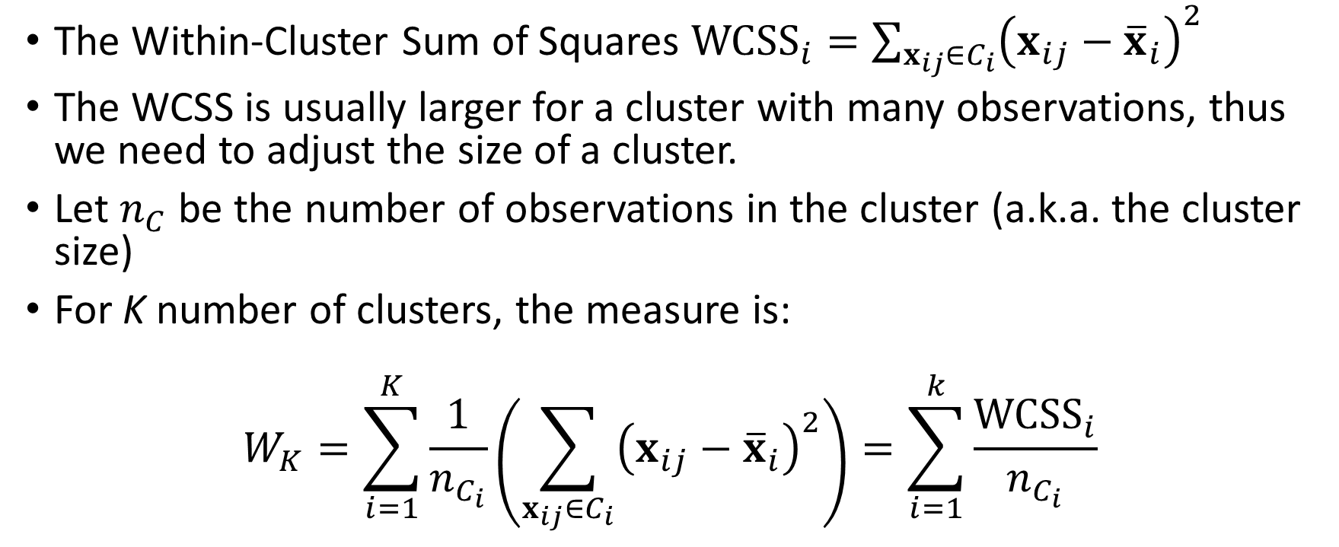
The Elbow Method
The Within-Cluster Sum of Squares ${WCSS}_{i}=\sum_{x_{ij}∈C_{i}}{{\left(x_{ij}−{\overline{x}}_{i}\right)}^{2}}$
The WCSS is usually larger for a cluster with many observations, thus we need to adjust the size of a cluster.
Let $n_{C}$ be the number of observations in the cluster (a.k.a. the cluster size)
For K number of clusters, the measure is:
$$W_{K}=\sum_{i=1}^{K}{\frac{1}{n_{C_{i}}}\left(\sum_{x_{ij}∈C_{i}}{{\left(x_{ij}−{\overline{x}}_{i}\right)}^{2}}\right)=\sum_{i=1}^{k}{\frac{{WCSS}_{i}}{n_{C_{i}}}}}$$

Slide 32
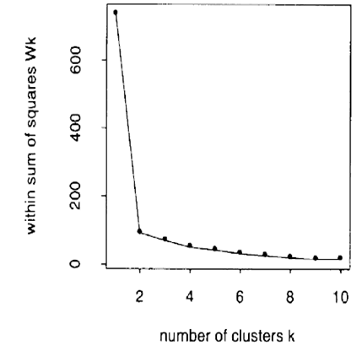
The Elbow Method
Create clusters for K = 1, 2, … and up to a conventionally specified upper limit
Plot W_{K} versus K
The curve is decreasing in theory
Select the K corresponding to the elbow in the L-curve (e.g., 2 from the graph on the right)

Slide 33
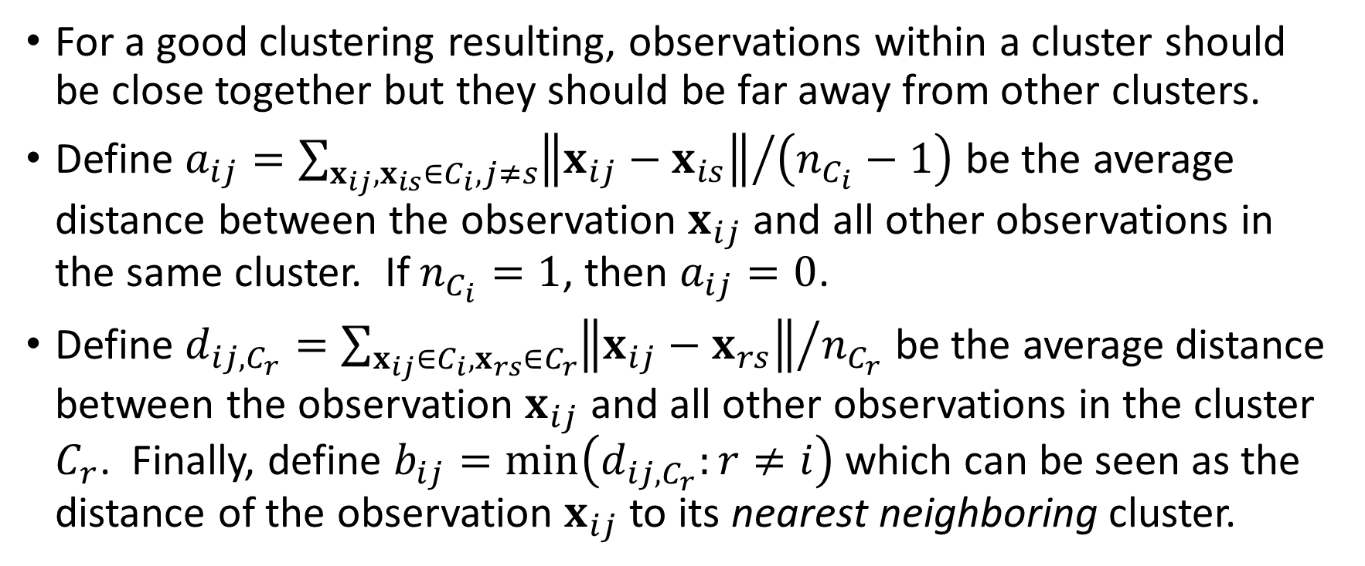
The Silhouette Method
For a good clustering resulting, observations within a cluster should be close together but they should be far away from other clusters.
Define $a_{ij}={\sum_{x_{ij},x_{is}∈C_{i},j≠s}{\left\|x_{ij}−x_{is}\right\|}}/{\left(n_{C_{i}}−1\right)}$ be the average distance between the observation $x_{ij}$ and all other observations in the same cluster. If $n_{C_{i}}=1$, then $a_{ij}=0$.
Define $d_{ij,C_{r}}={\sum_{x_{ij}∈C_{i},x_{rs}∈C_{r}}{\left\|x_{ij}−x_{rs}\right\|}}/{n_{C_{r}}}$ be the average distance between the observation $x_{ij}$ and all other observations in the cluster $C_{r}$. Finally, define $b_{ij}=min\left(d_{ij,C_{r}}:r≠i\right)$ which can be seen as the distance of the observation $x_{ij}$ to its nearest neighboring cluster.

Slide 34
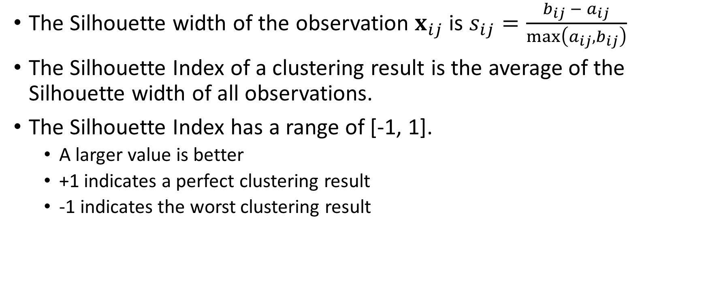
The Silhouette Method
The Silhouette width of the observation $x_{ij}$ is $s_{ij}=\frac{b_{ij} − a_{ij}}{max\left(a_{ij},b_{ij}\right)}$
The Silhouette Index of a clustering result is the average of the Silhouette width of all observations.
The Silhouette Index has a range of [-1, 1].
A larger value is better
+1 indicates a perfect clustering result
-1 indicates the worst clustering result

Slide 35
The Gap Statistic
Gap Statistic:
Normalize the curve log(W_{k}) versus k
Null hypothesis: reference distribution
Gap(k) = E(log(W_{k})) - log(W_{k}) where the expectation is of the reference distribution
Find the k that maximizes Gap(k)
Use Monte Carlo simulation (instead of a heuristic) to generate a hypercube reference distribution
Tibshirani, R., Walther, G., and Hastie, T. (2001). “Estimating the Number of Clusters in a Dataset via the Gap Statistic.” Journal of the Royal Statistical Society, Series B, 63: 411–423
Tibshirani_et_al-2001-Journal_of_the_Royal_Statistical_Society__Series_B_(Statistical_Methodology).pdf

Slide 36
Cubic Clustering Criterion (CCC)
The Cubic Clustering Criterion is based on the assumption that a uniform distribution on a hyper-rectangle is divided into clusters that are shaped approximately like hypercubes.
The Cubic Clustering Criterion idea is to compare the R² you get for a given set of clusters with the R² you would get by clustering a uniformly distributed set of points in p dimensional space.
Larger positive values of the CCC indicate a better solution, as it shows a larger difference from a uniform (no clusters) distribution. However, the CCC may be incorrect if clustering variables are highly correlated.
Read more about Cubic Clustering Criterion in SAS Technical Report A-108 (1983)
SAS Technical Report A108.pdf

Slide 37
Simple Example
Five observations in ascending order: 0.1, 0.3, 0.4, 0.8, and 0.9
Within-Cluster Sum of Squares (the inertia_ value)
Number of Clusters | Within-Cluster Sum of Squares | Elbow Value | Silhouette Value
1 | 0.46 | 0.092 | .
2 | 0.0517 | 0.0181 | 0.7208
3 | 0.01 | 0.005 | 0.5525
4 | 0.005 | 0.0025 | 0.31
5 | 0 | 0 | 0
Week 4 Kmeans.py

Slide 38
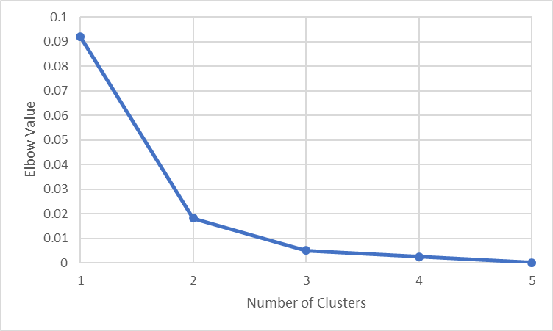
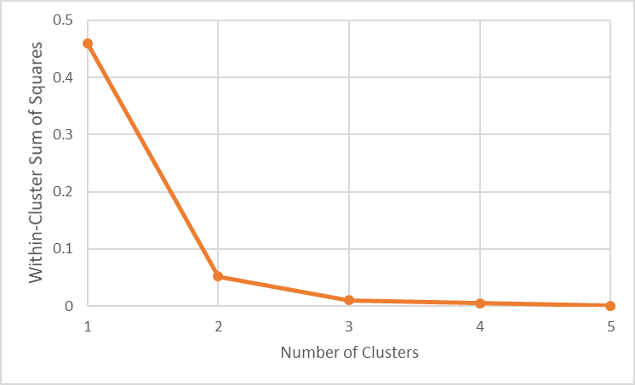
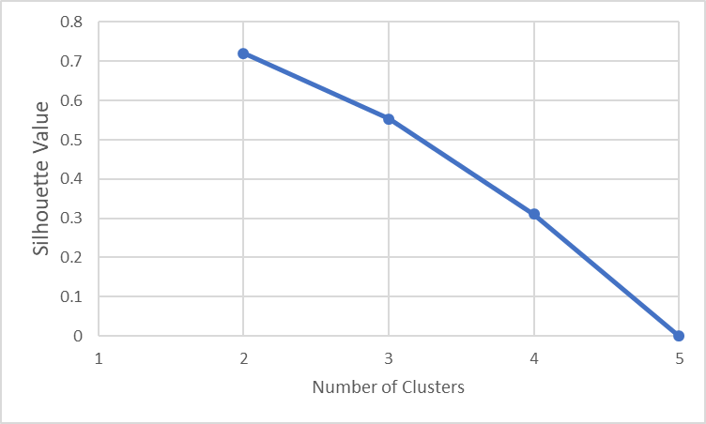
Simple Example

Slide 39
Clusters of Distances From Chicago
Driving distances (in miles) from Chicago to 59 cities
DistanceFromChicago.csv
Discover up to 15 clusters
CityState | StateCode | City | DrivingMilesFromChicago |  | CityState | StateCode | City | DrivingMilesFromChicago
Albany, NY | NY | Albany | 820 |  | Little Rock, AR | AR | Little Rock | 655
Albuquerque, NM | NM | Albuquerque | 1341 |  | Los Angeles, CA | CA | Los Angeles | 2028
Atlanta, GA | GA | Atlanta | 712 |  | Louisville, KY | KY | Louisville | 297
Baltimore, MD | MD | Baltimore | 704 |  | Memphis, TN | TN | Memphis | 536
Billings, MT | MT | Billings | 1247 |  | Miami, FL | FL | Miami | 1373
Birmingham, AL | AL | Birmingham | 661 |  | Milwaukee, WI | WI | Milwaukee | 92
Boise, ID | ID | Boise | 1702 |  | Minneapolis, MN | MN | Minneapolis | 407
Boston, MA | MA | Boston | 986 |  | Nashville, TN | TN | Nashville | 472
Buffalo, NY | NY | Buffalo | 531 |  | New Orleans, LA | LA | New Orleans | 927
Charleston, WV | WV | Charleston | 484 |  | New York, NY | NY | New York | 811
Charleston, SC | SC | Charleston | 911 |  | Norfolk, VA | VA | Norfolk | 891
Charlotte, NC | NC | Charlotte | 770 |  | Oklahoma City, OK | OK | Oklahoma City | 796
Cheyenne, WY | WY | Cheyenne | 968 |  | Omaha, NE | NE | Omaha | 469
Cleveland, OH | OH | Cleveland | 342 |  | Orlando, FL | FL | Orlando | 1152
Columbia, SC | SC | Columbia | 802 |  | Philadelphia, PA | PA | Philadelphia | 761
Columbus, OH | OH | Columbus | 352 |  | Phoenix, AZ | AZ | Phoenix | 1804
Dallas, TX | TX | Dallas | 933 |  | Pittsburgh, PA | PA | Pittsburgh | 460
Denver, CO | CO | Denver | 1009 |  | Portland, ME | ME | Portland | 1087
Des Moines, IA | IA | Des Moines | 333 |  | Portland, OR | OR | Portland | 2122
Detroit, MI | MI | Detroit | 278 |  | Rapid City, SD | SD | Rapid City | 909
EL Paso, TX | TX | EL Paso | 1488 |  | Reno, NV | NV | Reno | 1924
Fargo, ND | ND | Fargo | 644 |  | Saint Louis, MO | MO | Saint Louis | 300
Grand Junction, CO | CO | Grand Junction | 1252 |  | Salt Lake City, UT | UT | Salt Lake City | 1404
Hartford, CT | CT | Hartford | 903 |  | San Antonio, TX | TX | San Antonio | 1210
Houston, TX | TX | Houston | 1089 |  | San Diego, CA | CA | San Diego | 2088
Indianapolis, IN | IN | Indianapolis | 179 |  | San Francisco, CA | CA | San Francisco | 2148
Jackson, MS | MS | Jackson | 747 |  | Seattle, WA | WA | Seattle | 2070
Jacksonville, FL | FL | Jacksonville | 1058 |  | Washington, DC | DC | Washington | 705
Kanas City, MO | MO | Kanas City | 529 |  | Wichita, KS | KS | Wichita | 725
Las Vegas, NV | NV | Las Vegas | 1755
Week 4 Distance From Chicago.py

Slide 40
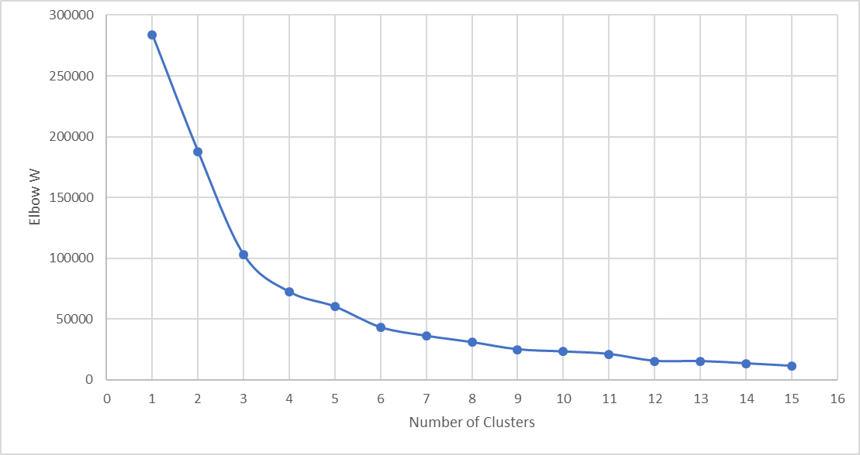
Clusters of Distances From Chicago
Number of Clusters | Elbow W
1 | 283894.49470
2 | 187758.44330
3 | 102762.12850
4 | 72117.19284
5 | 59977.70978
6 | 43009.44740
7 | 35976.15443
8 | 30744.71677
9 | 24872.10349
10 | 23059.31235
11 | 21039.24087
12 | 15339.02335
13 | 15204.20374
14 | 13337.71644
15 | 11278.23727

Slide 41
Clusters of Distances From Chicago
Number of Clusters | Elbow W | Slope | Acceleration
1 | 283894.49470
2 | 187758.44330 | -96136.05
3 | 102762.12850 | -84996.31 | 11139.74
4 | 72117.19284 | -30644.94 | 54351.38
5 | 59977.70978 | -12139.48 | 18505.45
6 | 43009.44740 | -16968.26 | -4828.78
7 | 35976.15443 | -7033.29 | 9934.97
8 | 30744.71677 | -5231.44 | 1801.86
9 | 24872.10349 | -5872.61 | -641.18
10 | 23059.31235 | -1812.79 | 4059.82
11 | 21039.24087 | -2020.07 | -207.28
12 | 15339.02335 | -5700.22 | -3680.15
13 | 15204.20374 | -134.82 | 5565.40
14 | 13337.71644 | -1866.49 | -1731.67
15 | 11278.23727 | -2059.48 | -192.99
Largest Acceleration (i.e., change of slope)

Slide 42
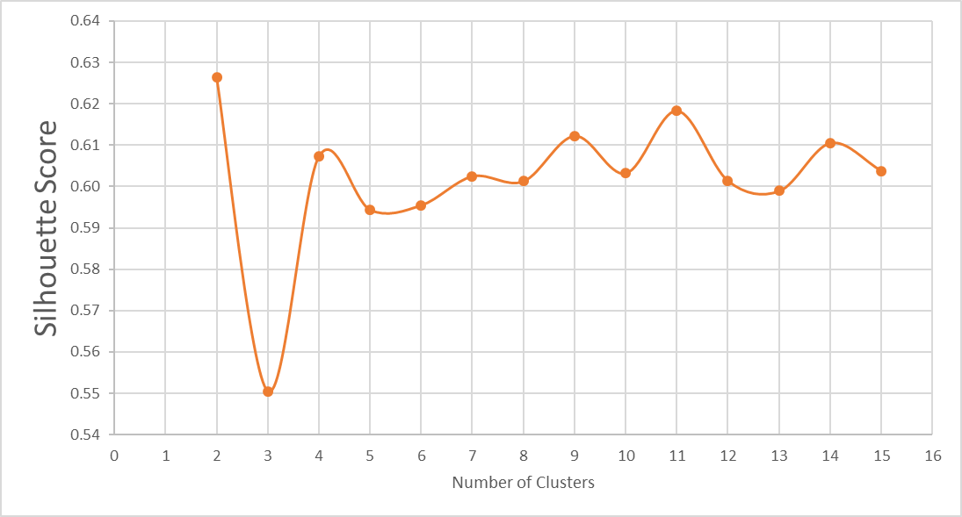
Clusters of Distances From Chicago
Number of Clusters | Silhouette
1
2 | 0.6264
3 | 0.5505
4 | 0.6073
5 | 0.5944
6 | 0.5955
7 | 0.6025
8 | 0.6013
9 | 0.6123
10 | 0.6032
11 | 0.6184
12 | 0.6013
13 | 0.5989
14 | 0.6106
15 | 0.6038

Slide 43
Clusters of Distances From Chicago
Pick the 4 clusters solution.
Cluster | Size | Centroid | WCSS
0 | 23 | 815.2 | 280147.9130
1 | 9 | 1960.1 | 228916.8889
2 | 11 | 1245.5 | 204122.7273
3 | 16 | 378.8 | 255120.4375
SAS Technical Report A108.pdf

Slide 44
Cities in Clusters of Distances From Chicago
Cluster 0 | Cluster 1 | Cluster 2 | Cluster 3
Albany, NY Atlanta, GA Baltimore, MD Birmingham, AL Boston, MA Charleston, SC Charlotte, NC Cheyenne, WY Columbia, SC Dallas, TX Denver, CO Fargo, ND Hartford, CT Jackson, MS Little Rock, AR New Orleans, LA New York, NY Norfolk, VA Oklahoma City, OK Philadelphia, PA Rapid City, SD Washington, DC Wichita, KS | Boise, ID Las Vegas, NV Los Angeles, CA Phoenix, AZ Portland, OR Reno, NV San Diego, CA San Francisco, CA Seattle, WA | Albuquerque, NM Billings, MT EL Paso, TX Grand Junction, CO Houston, TX Jacksonville, FL Miami, FL Orlando, FL Portland, ME Salt Lake City, UT San Antonio, TX | Buffalo, NY Charleston, WV Cleveland, OH Columbus, OH Des Moines, IA Detroit, MI Indianapolis, IN Kanas City, MO Louisville, KY Memphis, TN Milwaukee, WI Minneapolis, MN Nashville, TN Omaha, NE Pittsburgh, PA Saint Louis, MO

Slide 45
Biclustering / Co-clustering / Block Clustering
Discover clusters among the observations (i.e., the rows) and the variables (i.e., the columns) at the same time.
Hartigan, J.A. (1972). Direct Clustering of a Data Matrix. Journal of the American Statistical Association, Volume 67, Number 337, Pages 123- 129.
Cheng, Y. and Church, G. M. (2000). Biclustering of Expression Data. Proceedings of the 8th International Conference on Intelligent Systems for Molecular Biology, La Jolla, California, 2000, pages 93–103.
Pontesa, Beatriz, Giráldezb, Raúl, and Aguilar-Ruiz, Jesús S. (2015). Biclustering on Expression Data: A Review. Journal of Biomedical Informatics, Volume 57, October 2015, Pages 163-180

Slide 46
Application of Biclustering
We commonly calculate the correlation matrix of a list of continuous variables as a first step to explore correlations among the variables.
The cars.csv has these eight continuous variables: EngineSize, Cylinders, Horsepower, MPG_City, MPG_Highway, Weight, Wheelbase, Length.
After removing missing values (i.e., Nan) in the Cylinders, the data has 426 observations in 8 variables.

Slide 47
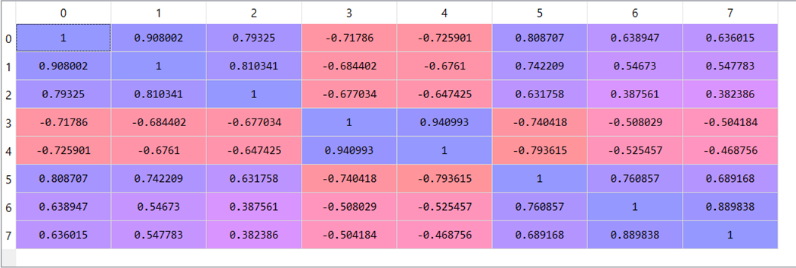
Application of Biclustering
0: EngineSize, 1: Cylinders, 2: Horsepower, 3: MPG_City, 4: MPG_Highway, 5: Weight, 6: Wheelbase, 7: Length

Slide 48
Application of Biclustering
The colors only show the positive (purple) and the negative (red) correlations.
A big question is: Are there any clusters among the correlations?
Ideally, we want to show block diagonals in the correlation matrix.
In other words, we want to find clusters of variables which are either positively or negatively correlated.
Let us try 3 clusters in both row and column dimensions

Slide 49
Application of Biclustering
 | Horsepower | Length | Wheelbase | MPG_City | MPG_Highway | Cylinders | EngineSize | Weight
Horsepower | 1.0000 | 0.3824 | 0.3876 | -0.6770 | -0.6474 | 0.8103 | 0.7932 | 0.6318
Length | 0.3824 | 1.0000 | 0.8898 | -0.5042 | -0.4688 | 0.5478 | 0.6360 | 0.6892
Wheelbase | 0.3876 | 0.8898 | 1.0000 | -0.5080 | -0.5255 | 0.5467 | 0.6389 | 0.7609
MPG_City | -0.6770 | -0.5042 | -0.5080 | 1.0000 | 0.9410 | -0.6844 | -0.7179 | -0.7404
MPG_Highway | -0.6474 | -0.4688 | -0.5255 | 0.9410 | 1.0000 | -0.6761 | -0.7259 | -0.7936
Cylinders | 0.8103 | 0.5478 | 0.5467 | -0.6844 | -0.6761 | 1.0000 | 0.9080 | 0.7422
EngineSize | 0.7932 | 0.6360 | 0.6389 | -0.7179 | -0.7259 | 0.9080 | 1.0000 | 0.8087
Weight | 0.6318 | 0.6892 | 0.7609 | -0.7404 | -0.7936 | 0.7422 | 0.8087 | 1.0000
Cluster ID | Variables
0 | Horsepower, Length, Wheelbase
1 | MPG_City, MPG_Highway
2 | Cylinders, EngineSize, Weight
Week 4 BiCluster.py

Slide 50
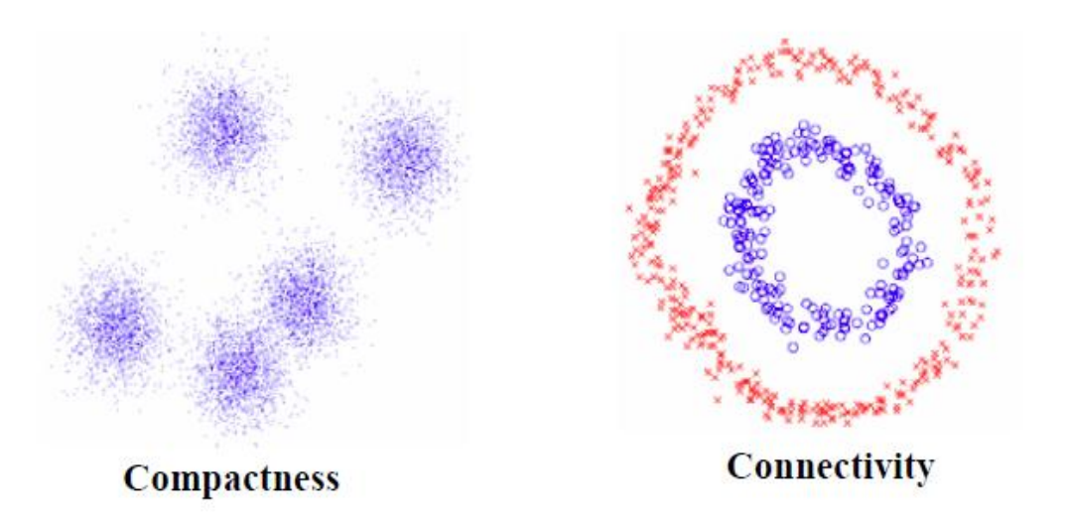
Spectral Clustering
The K-Means algorithm works well if the data are compact
However, the K-Means algorithm does not work well (or does not work at all) if the data are connected but not necessarily compact

Slide 51
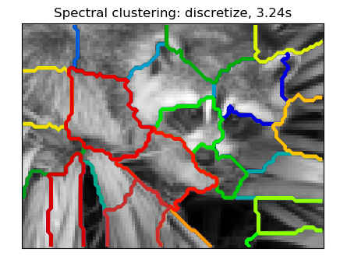
Spectral Clustering
Examples of data that are connected but not necessarily compact
http://scikit-learn.org/stable/auto_examples/cluster/plot_face_segmentation.html#sphx-glr-auto-examples-cluster-plot-face-segmentation-py

Slide 52
Spectral Clustering
Spectral clustering is a technique for clustering based on transformation by dimensionality reduction.
References: Ulrike von Luxburg (2007). “A Tutorial on Spectral Clustering”. Statistics and Computing. 17(4): 395-416.

Slide 53
Spectral Clustering Algorithm
Calculate the distances among the observations.
Calculate the Adjacency matrix based on the distances.
Calculate the Degree matrix based on the Adjacency matrix
Subtract the Adjacency matrix from the Degree matrix, called the result as the Laplacian matrix
Obtain eigenvectors of the Laplacian matrix
Apply the K-Means algorithm on the selected eigenvectors

Slide 54
Adjacency Matrix
2
 | 1 | 2 | 3 | 4
1 | a11 | a12 | a13 | a14
2 | a21 | a22 | 0 | 0
3 | a31 | 0 | a33 | a34
4 | a41 | 0 | a43 | a44
1
4
Symmetry requirement: aij = aji
Points further away have lower adjacency value, i.e., a11 ≥ a13 ≥ a14 ≥ a12 ≥ 0
We may use the Nearest Neighbors to explicitly assign zero to points that are not a point’s nearest neighbors.
3

Slide 55
Degree Matrix
2
 | 1 | 2 | 3 | 4
1 | d11 | 0 | 0 | 0
2 | 0 | d22 | 0 | 0
3 | 0 | 0 | d33 | 0
4 | 0 | 0 | 0 | d44
1
4
dij = ai1 + ai2 + ai3 + ai4
The Degree value of a point is higher when more points are connected to it.
3

Slide 56
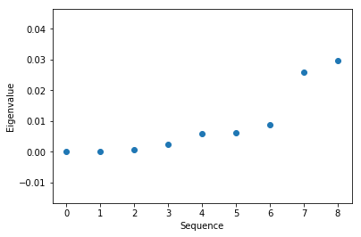
Sequence Plot of the Eigenvalues
Plot the first few eigenvalues from the smallest to the highest.
Look for an obvious jump in the graph
The threshold value may suggest a more appropriate number of neighbors

Slide 57
Number of Eigenvectors to be Used
Select eigenvectors that correspond to the eigenvalues selected, starting from the smallest eigenvalue.
Usually, the number of eigenvectors selected is the same as the number of fields used for clustering in the original training data.

Slide 58
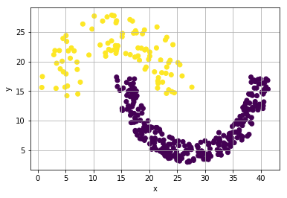
Example of Spectral Clustering
Sample data: http://cs.joensuu.fi/sipu/datasets/jain.txt
373 observations
Two input fields with a known cluster identifier field
Week 4 Jain Spiral.py

Slide 59
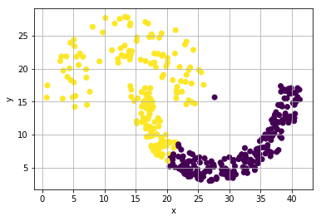
Directly Apply K-Mean on the Sample Data
Request a two-cluster solution.
The upper arc is almost completed identified correctly.
About 1/3 of the lower arc is not identified correctly.

Slide 60
Adjacency and Degree Matrices
Calculate the Euclidean distance among all observations.
Calculate the Adjacency value as exp(- distance).
Except for the 8 nearest neighbors of a row in the Adjacency matrix, assign zeros to all other columns. (Note: we will find out in a moment that 8 nearest neighbors is good. As for now, just guess)
Make sure the Adjacency matrix is symmetric.
Calculate the Degree matrix
Calculate the Laplacian matrix = Degree – Adjacency which is a 373 x 373 symmetric square matrix.

Slide 61
Adjacency and Degree Matrices
# Three nearest neighbors
kNNSpec = sklearn.neighbors.NearestNeighbors(n_neighbors = 8, algorithm = 'brute', metric = 'euclidean')
nbrs = kNNSpec.fit(trainData)
d3, i3 = nbrs.kneighbors(trainData)
# Retrieve the distances among the observations
distObject = sklearn.neighbors.DistanceMetric.get_metric('euclidean')
distances = distObject.pairwise(trainData)
# Create the Adjacency and the Degree matrices
Adjacency = numpy.zeros((nObs, nObs))
Degree = numpy.zeros((nObs, nObs))
for i in range(nObs):
for j in i3[i]:
if (i <= j):
Adjacency[i,j] = math.exp(- distances[i][j])
Adjacency[j,i] = Adjacency[i,j]
for i in range(nObs):
sum = 0
for j in range(nObs):
sum += Adjacency[i,j]
Degree[i,i] = sum
Lmatrix = Degree - Adjacency
from numpy import linalg as LA
evals, evecs = LA.eigh(Lmatrix)
# Series plot of the smallest ten eigenvalues to determine the number of clusters
plt.scatter(numpy.arange(0,9,1), evals[0:9,])
plt.xlabel('Sequence')
plt.ylabel('Eigenvalue')
plt.show()

Slide 62
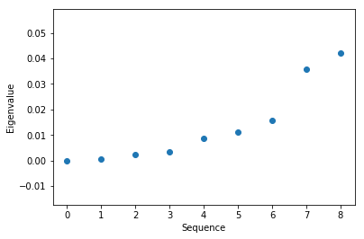
Eigenvalues
Plot the first ten eigenvalues versus their sequences.
The graph confirms that the eight nearest neighbors solution is appropriate.

Slide 63
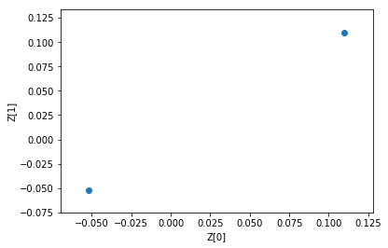
Eigenvectors
# Inspect the values of the selected eigenvectors
Z = evecs[:,[0,1]]
print(Z[[0]].mean(), Z[[0]].std())
print(Z[[1]].mean(), Z[[1]].std())
plt.scatter(Z[[0]], Z[[1]])
plt.xlabel('Z[0]')
plt.ylabel('Z[1]')
plt.show()
Since the original data have two features, plot the first two eigenvectors which are 373 x 2 vectors.
The graph suggests a two clusters K-mean solution.

Slide 64
Final K-Mean Solution
kmeans_spectral = cluster.KMeans(n_clusters=2, random_state=0).fit(Z)
Spiral['SpectralCluster'] = kmeans_spectral.labels_
plt.scatter(Spiral[['x']], Spiral[['y']], c = Spiral[['SpectralCluster']])
plt.xlabel('x')
plt.ylabel('y')
plt.grid(True)
plt.show()
It looks like the spectral clustering method works for this dataset.

Slide 65
Assignment 2
Assignment 2 will be posted on Thursday, September 12, 2019
Due date is 11:59 pm on Wednesday, September 18, 2019
Maximum two attempts, only the most recent attempt is graded
Must submit Python codes with assignment, otherwise deduct 50% of your question score
Name your Python codes or Jupyter notebooks as Q1.py or Q1.ipynb

